Slide 1

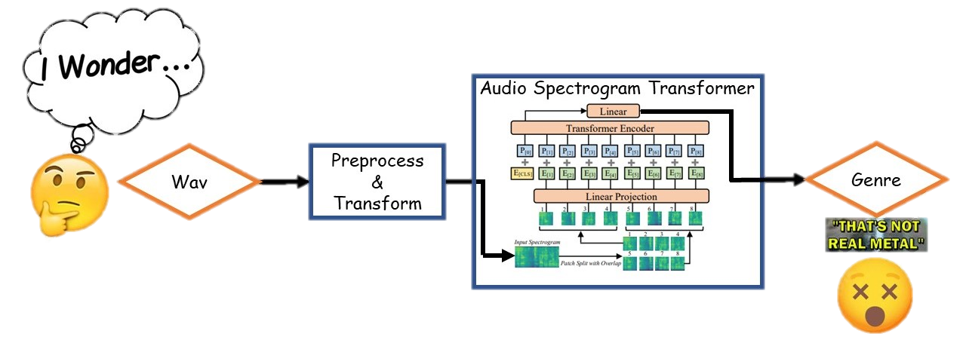
Music Genre Classification Using An Audio Spectrogram Transformer

Slide 2

Classical
Rock
Reggae
Blues
GTZAN
Pop
Country
Metal
Disco
Jazz
Hiphop
https://huggingface.co/datasets/marsyas/gtzan

Slide 3
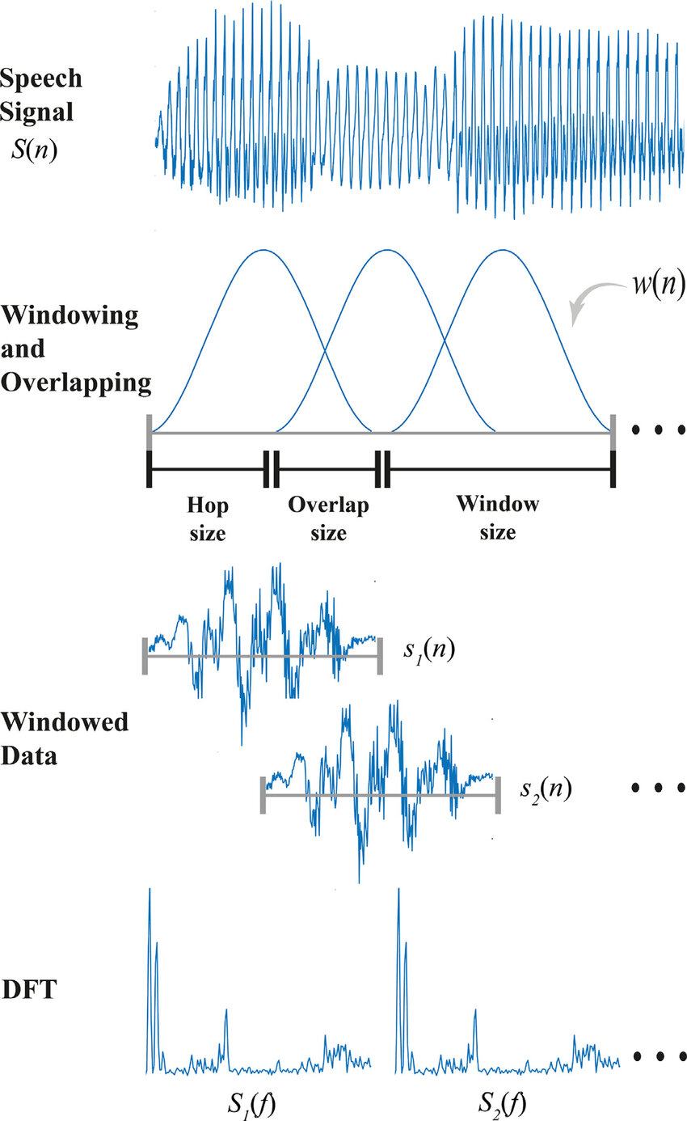
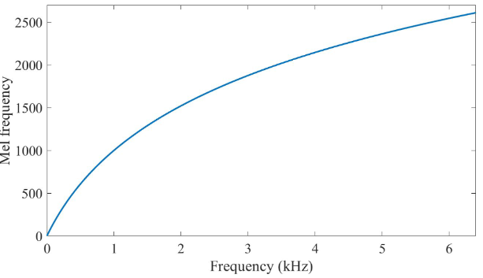
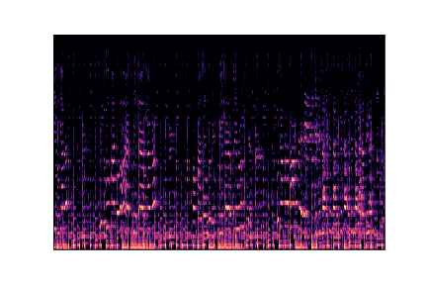
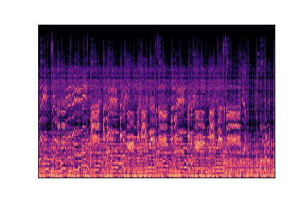
MeL spectrograms
Reggae
Metal
https://github.com/musikalkemist/AudioSignalProcessingForML
https://www.youtube.com/watch?v=iCwMQJnKk2c&list=PL-wATfeyAMNqIee7cH3q1bh4QJFAaeNv0

Slide 4
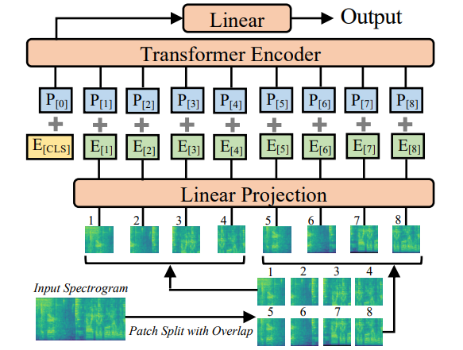
Audio Spectrogram Transformer
AST: Audio Spectrogram Transformer, Yuan Gong et al. 2021
https://huggingface.co/docs/transformers/en/model_doc/audio-spectrogram-transformer

Slide 5
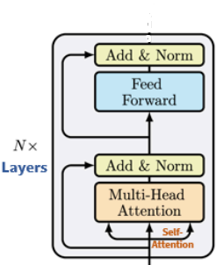
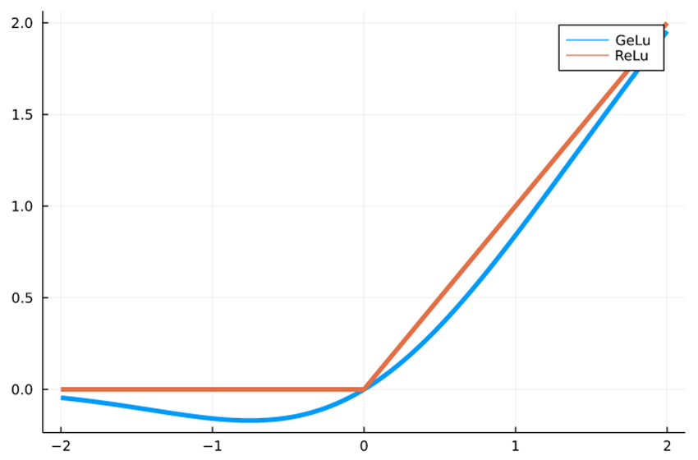

Fine Tuned Architecture
2 FC layers with dropout
DoRA
$$W=\left\|W_{0}\right\|\frac{W_{0}+αAB}{\left\|W_{0}+αAB\right\|}$$
$W_{0}∈ℝ^{d_{in}×d_{out}}$
$$A∈ℝ^{d_{in}×r},B∈ℝ^{r×d_{out}}$$

Slide 6
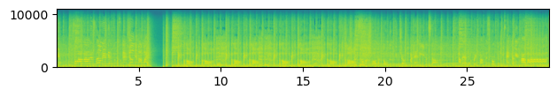

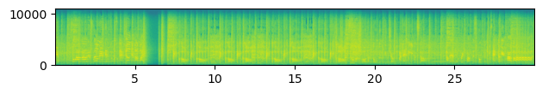
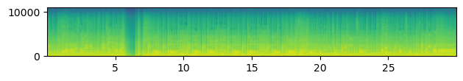
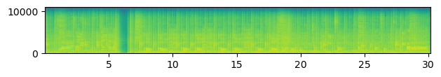
Audio Augmentation
The Original sample
To enrich the training process, we added variations of the train-set with effects to itself. Diversity to improve performance and generalization.
Change of pace: a fast-paced and a slow-paced samples. Adds variety in the pacing of the data, to fit real world.
The sample after slow-paced effect
Frequency filter: a high-pass and low-pass filters samples. Adding the feeling of distance, volume, and recordings.
The sample after High-pass frequency filter
Sample with Echo effects: Music played in live concerts usually has reflecting acoustic from the surrounding.
Sample with a bundle(ensemble) of some of the effects.
The sample after Low-pass frequency filter
The parameters for each effect are chosen randomly for each sample.
The sample after echo effect
Notes:
In-gain and Out-gain are coefficients of the acoustic wave, for how much a wave passed through firstly and then secondly. – Imagine a Wave through different energy levels.

Slide 7
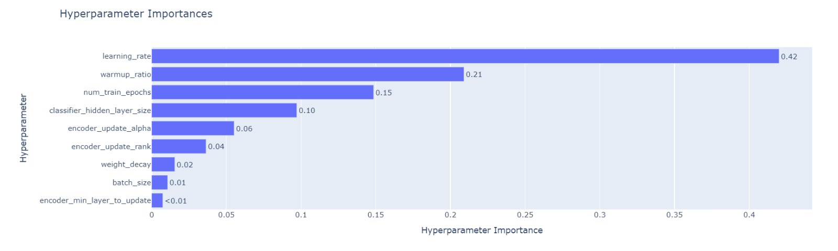
Hyperparameters Search - Optuna
Aside the normal parameters we seek in training, we also have hyperparameters that define our model arch and training.
We use Optuna, an automatic framework for hyperparameter optimization. It is simple and fully supported over HF Trainer API.
Our Hyperparameter space is(After HP search):
The learning rate: ~0.0001322
Warmup ratio: ~0.085
Classifier hidden layer size: 200
Weight decay: ~0.067624
Training batch size: 16
Training number of epochs: 13
Encoder min layer to update: 10
Encoded updated alpha and rank
Hyperparameters search results: We ran 35 trials and reached 87-89% evaluation accuracy and 83-87% on test set.
Notes:
Weight decay – The scalar multiplier of the L2 regulation (\lambda w^Tw)
Gradient accumulation steps – מספר צעדי העדכון שנצבור את הגראדיאנטים לפני ביצוע backward/forward pass
Warmup ratio – יחס ממספר הכולל של צעדי האימון, שבהם נבצע שינוי בקצב לינארי מ0 לקצב הלמידה הרצוי

Slide 8
Generalization
We have tested our model, with some samples from the Jamendo website. A huge music platform with more than 400,000 titles free to use for the public with metadata like genre for personal use.
And have reached these finding in average confidence:
Burning You(Blues) – 49% Pop
Clair De Lune(Classical) – 93% classical
Golden Standard(Country) – 78% Country
Magenta Six(Disco) – 68% Pop
Royalty(Hiphop) – 56% Pop
For the Fifth(Jazz) – 75% Jazz
After Us (Metal) – 81% Metal
Love You Anymore (Pop) – 97% Pop
The River (Raggae) – 83% Pop
Molotov Heart (Rock) – 68% Metal

Slide 9
Questions?

Slide 10
Summary
At this project, we have utilized some of topics we have learned in class, in real world scenarios.
We have shown in this project, that even for a dataset that was researched more than once. As learning architecture technologies keeps evolving, there are still more to learn. For example, the uncovered potential of Transformer based models.
Furthermore, the main principle of our project, Transfer Learning and Fine-Tuning: By utilizing existing pre-trained model on a task close to ours, we managed to bridge new methods in short time to our task.
Notes:
Transfer Learning and Fine-Tuning are learning technics utilizing pre-trained models as starting point for a new task.. Transfer Learning is to use a model pre-trained on a large dataset and to apply on a smaller dataset. Training only on new added layers, like our classification head/output.
Fine-Tunning is training some of original layers…

Slide 11
